Slide 1
Trends & Best Practices in International Recruiting
Shelby L. Cearley and Dr. Claudia Cogliser
Texas Tech University
September 2016

Slide 2
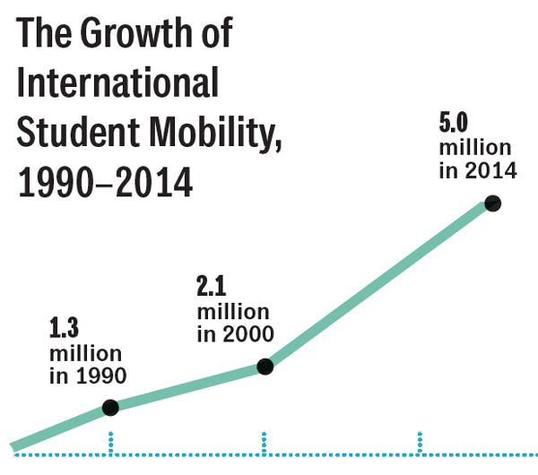
International Student Mobility in 2015
5 million students+ studied outside their home country
Asia continues to dominate, but there are emerging markets
China, India and South Korea remain the top three senders
Brazil, Vietnam, Indonesia, and Nigeria considered top emerging
http://monitor.icef.com/2015/11/the-state-of-international-student-mobility-in-2015/
Notes:
Per ICEF (November 2015), more than 5 million students studied outside of their home countries last year, more than double the number in 2000. This number includes both degree-seeking and ESL students. ICEF, QS, and EducationUSA all confirm that Asia continues to dominate, with China, India and South Korea remaining as the top three sending countries. However, several markets are considered to be the next hot spots: Brazil, Vietnam, Indonesia, and Nigeria. Brazil remains an emerging despite the political situation this year and despite the changes with the Brazil Science Mobility Program. Nigeria’s emergence may be affected by recent terror group activity, but the numbers remain strong.

Slide 3
Why Recruit International Students?
Desire to grow your student body
Campus internationalization efforts
Increased campus diversity
What else can you think of?
Notes:
This may seem like a rhetorical question, but this is something that needs to be considered at each individual institution. Why do you want international students on your campus? The most popular reasons are listed here: desire to grow your student body, campus internationalization efforts, and to increase your campus diversity. What other reasons can you think of? You need to be able to articulate your reasons to help you create/edit your international recruitment and marketing plan, so make sure you can answer this question fully.

Slide 4
Where to Begin
Start with what you have
Do an internal audit.
Ask questions of your current international students, alumni, faculty/staff, and community
Figure out your selling points – what do you have to offer
Review/revamp/create an international recruiting and marketing plan
Diversify beyond the top countries to include a mix of growth and risk
Cultivate and implement a multi-pronged recruitment plan based on your needs, not a “one-size-fits-most” mentality
Be prepared to make a multi-year commitment
Notes:
The first step is to begin with what you have. What do we mean? Talk to current international students and ask them how they found out about, applied to, and enrolled at your institution. Contact international alumni and ask them to act as alumni counselors for prospective students in their country. Reach out to international community sources in your city and promote your institution to them through international events on campus and localized communications in their language including advertising and media to their community. Ask visiting scholars or faculty for advice. Ask yourself the following questions: What does your institution have that would make it attractive for international students? How do your institution’s programs, facilities and location relate to the price/value continuum of higher education in your city, region or state? If you have had international students in the past, where did they come from and what did they study? Are there any ethnic communities near your school and have you engaged with them? Do you have the infrastructure in place to support international students? Do you have an intensive English program on or near to your campus?
If you do not have a recruiting plan or if you don’t have international as part of your recruiting plan, it’s time to create one. When you do, focus on your institution’s top markets. That may be China, India, Korea, etc, but based on your unique campus, your top countries may be different. Review your data for the past five years to see what your top sending countries and top programs have been. Keep these in your plan, but also look at data from EducationUSA’s Going Global Guide, IIE Open Doors, etc, for possible new markets. Choose 2-3 new markets and add them to your plan. When creating or editing your recruiting plan, consider both armchair and active recruiting initiatives and plan accordingly. You will need to commit to putting staff and financial resources into credential evaluation, immigration advising, recruitment travel and lead generation, to name a few things. Lastly, be prepared to make a minimum commitment to three years to your markets. Why? Results from your recruitment initiatives can take as long as three years to be fully implemented and yield the desired results.

Slide 5
Ways to Recruit
Provide outstanding service from first contact to graduation
Fairs/presentations
Cooperation with international institutions
Social media
Purchased names
International alumni
Other ways?
Notes:
What are the ways you can recruit? These should be fairly self-explanatory. First, you must be prepared to provide outstanding customer service from the first contact. Word of mouth is still the best recruiting tool, so make sure that you can provide that. Fairs and presentations remain important. This can include both here in the US since there are a good number of international students already studying in the US. You can use tour providers like Linden and FPP Media, or you may want to consider the EducationUSA fair circuits. Not ready to travel yet? You can still partner with EducationUSA to provide information sessions through their network, and you can also host your own information sessions through services like GoTo Webinar/GoTo Meeting or Adobe Connect. What arrangements do you already have with international institutions, and how can you leverage that in your recruiting? Social media can also be a great recruiting tool. The caveat here is that you will need to make sure that the social media channels you want to use are available in the markets you choose. Purchasing names from GRE, TOEFL, and GMAT are a way to get names. Also, your international alumni can be quite helpful in helping you recruit – they can be used to provide written/video testimonials and also to represent you at international fairs if you are not able to travel. What other ways have worked for you?

Slide 6
Want More Information?
EducationUSA Going Global guide - https://educationusa.state.gov/sites/default/files/edusa_global_guide_2015.pdf
IIE Open Doors - http://www.iie.org/research-and-publications/open-doors/data
NAFSA’s international recruitment resources - https://www.nafsa.org/findresources/Default.aspx?id=8856
American International Recruitment Council - http://www.airc-education.org/
Notes:
You can find a wealth of information regarding trends and statistics in EducationUSA’s Going Global guide, which is updated yearly, and the IIE Open Doors annual report. NAFSA also has a list of resources and best practices available on its International Enrollment Management knowledge community. The American International Recruitment Council offers information on best practices in international recruiting and also about working with recruiting agents. Shelby maintains a blog with conference materials and handouts related to international admissions, including a section on recruiting, at shelbycearley.wordpress.com

Slide 7
Thank you!
Claudia Cogliser – claudia.cogliser@ttu.edu
Shelby Cearley – shelby.l.cearley@ttu.edu

