Slide 1
Graduate Education Advisory Committee (GEAC) update
Meharvan Singh, PhD
Chair, GEAC
Dean, Graduate School of Biomedical Sciences
UNT Health Science Center

Slide 2
A report on two key areas
Activity of the GEAC during FY 2016
Information on the activity of the RAND group
Commissioned to assess the need to expand graduate programs in Texas higher education institutions

Slide 3
What is the GEAC
“The Graduate Education Advisory Committee (GEAC) advises agency staff and Board Members on procedures, issues, and long-range planning relating to graduate education
The GEAC is comprised of faculty and administrators from the state’s public and private universities, and health-related institutions, plus one non-voting student member.
Source: www.THECB.state.tx.us

Slide 4
Major topics discussed
Texas Higher Education Coordinating Board’s 60x30TX strategic plan
Competency-based education for graduate programs
Characteristics of Professional Doctoral Programs
RAND study on graduate education

Slide 5
THECB’s strategic plan for 2015-2030
Overarching goal: By 2030, at least 60 percent of Texans aged 25-34 will have a certificate or degree
>550,000 students by 2030
Programs in support of this goal will have identifiable marketable skills
By 2030, undergraduate student loan debt will not exceed 60% of first year wages for graduates of Texas public institutions

Slide 6
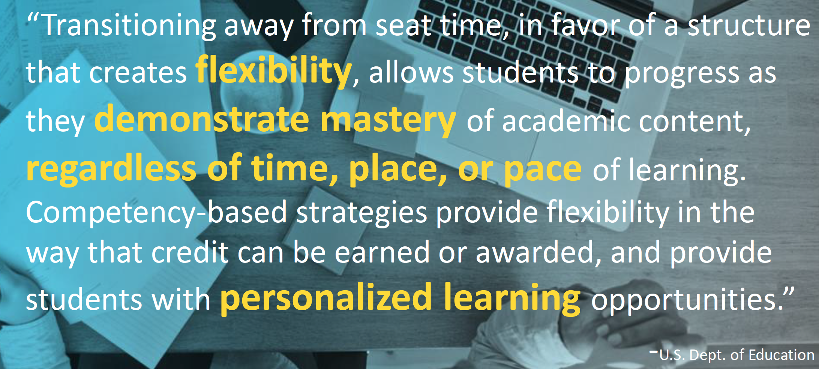
Competency-based graduate programs
Potentially allows for prior (work) experience and education to count towards degree
Attentive to skills and competencies
Flexible curriculum
Technology-rich
Alternative cost models

Slide 7
Characteristics of Professional Doctoral Programs
Akin to the “18 Characteristics of Doctoral Programs”
Developed by the Graduate Education Advisory Committee to create a snapshot of all doctoral programs at public universities and health-related institutions.
Created in 2008, revised in 2010
Still in development….
Stay tuned

Slide 8
The RAND study on Graduate Education
The following slides are a courtesy of:
Charles A. Goldman, PhD
Senior Economist at RAND Corporation

Slide 9
Managing the Expansion of Graduate Education in Texas
Rita Karam Charles A. Goldman Daniel Basco Diana Carew
September 2016
This briefing has not been formally reviewed, edited, or cleared for public release. It should not be cited without the permission of the RAND Corporation. RAND's publications do not necessarily reflect the opinions of its research clients and sponsors.

Slide 10
The study has three objectives (and intended to support the 60x30TX Strategic Plan)
Assess the need to expand graduate programs in Texas higher education institutions
Provide guidance to THECB and higher education institutions on how to prepare and evaluate graduate program proposals
Analyze policies that can manage needed expansion of graduate programs in Texas

Slide 11
We conducted seven tasks
Task
1 | Review THECB inventory of graduate programs
2 | Review other states’ policies and practices on graduate program expansion
3 | Assess Texas’s position in graduate education and research
4 | Compare program offerings to state economic needs, strategic goals, and labor market
5 | Conduct case studies in example fields
6 | Interview Texas university system leaders
7 | Recommend ways to improve proposal preparation and review

Slide 12
For the case studies, we selected 12 institutions to represent all public higher education peer groups
Peer Group | Institutions
Research | 2
Emerging Research | 5
Doctoral | 1
Comprehensive | 1
Masters | 1
Health-related | 2
Total | 12

Slide 13
We interviewed representatives of several groups
Organization Type | Institutions | Participants
TX higher education institutions | 12 | 145
TX university systems | 3 | 7
Other state university systems | 3 | 6
Employers | 8 | 8
Total | 26 | 166

Slide 14
Project Schedule
Event | Date
Draft report circulated for public comment and peer review | September-October 2016
Final report drafted | December 2016
Final report edited and published | February 2017

Slide 15
Position of Texas in graduate education and research

Slide 16
Logic model describes relationships between graduate education and research and Texas state interests
INPUTS
OUTPUTS
OUTCOMES
IMPACTS
R&D $
STATE $
Workforce
Innovation
Business growth
Institutional prestige
RESEARCH
STU-
DENT $
HIGHER EDUCATION
STATE COMPETITIVENESS
GRADUATES

Slide 17
Texas has increased graduate degrees by 41%, but still produces fewer than CA and NY
Graduate/professional degrees
Source: IPEDS (not scaled)
Notes:
Per capita – Texas is at par with California

Slide 18
Overall federal R&D funding has been flat (except for stimulus); Texas’s share is declining
In 2013, TX received 34% of CA’s level, or 49% adjusted for population
Source: NSF (not scaled)

Slide 19
Despite not growing federal R&D funding, Texas has significantly increased its recognized research universities
Carnegie Research (1, 2, 3) Universities
Total number in USA increased 20%
Source: Carnegie (not scaled)

Slide 20
Texas graduate production is increasing most in business and health
FL, CA, NY are growing in engineering much faster than Texas
Source: IPEDS (not scaled)

Slide 21
Texas labor market demand and need for graduate education

Slide 22
Business, Healthcare, and Education Occupations Have Highest Projected Demand
RAND analysis of TWC and Census (ACS) data

Slide 23
Findings from Texas case studies on graduate program decision-making and proposal processes

Slide 24
We find multiple motivators that drive institutions to propose new graduate programs
Seeking to become a research-intensive university
INSTITUTIONAL
Seeking to become known in a specific field or market and possibly move up classifications
Positive margin activity
Competition
Labor market demand
Student demand
Emerging multidisciplinary field
Professional degree upgrading
DEPARTMENTAL

Slide 25
Conclusions and Recommendations

Slide 26
Texas is likely to need increased activity in graduate education and research
Texas has a number of nationally- and internationally-competitive universities and health-related institutions
Efforts to increase competitiveness should focus on institutions with moderate to high research activity
Graduate demand is expected to be strong especially in fields where it is already strong
New or expanded programs will be needed

Slide 27
Expansion of graduate education could fuel prestige-seeking
State could benefit from increasing number of nationally- and internationally-competitive research universities
But prestige-seeking warrants some caution in reviewing proposals and calls for periodic review of access and excellence

Slide 28
The study makes key recommendations
Maintain and consider increasing state matching funds to raise research competitiveness
Review proposals’ alignment with institutional strategic plans
Use labor market and student demand data more systematically
Explore ways to monitor quality of online programs
Develop strategy for domestic pipelines into the science fields
Encourage earlier, informal proposal review at institutions and with THECB

Slide 29
Thank you! Questions?

