Slide 1
Balancing Graduate Education and the Development of a Career Trajectory

Slide 2
Balancing Graduate Education and the Development of a Career Trajectory
Mahesh Vanjani
Associate Dean
The Graduate School
Texas Southern university

Slide 4
Texas Southern University (TSU)
Texas Southern University (TSU) is a public historically black university (HBCU) in Houston, Texas. The university is one of the largest and most comprehensive HBCUs in the nation. TSU is a leading conferrer of college degrees to African Americans and Hispanics in Texas and ranks fourth in the United States in doctoral and professional degrees conferred to African Americans.
Texas Southern University's history dates back to 1927. The university eventually become a state-supported institution of higher education and was finally rebranded as Texas Southern University on June 1, 1951.
Today, TSU offers bachelor’s, master’s, and doctoral programs in the following academic colleges and schools: College of Liberal Arts and Behavioral Sciences, College of Pharmacy and Health Sciences, College of Science, Engineering and Technology, College of Education, Barbara Jordan-Mickey Leland School of Public Affairs, School of Communication, Thurgood Marshall School of Law, Jesse H. Jones School of Business, Thomas F. Freeman Honors College, and the Graduate School.
At the Graduate level, TSU offers 27 Masters, 3 Doctor of Education (EDD), and 4 PHD programs.

Slide 5
TSU Fall 2019
Students Enrolled: 9,448
Graduate: 1,071 (11.5%)
Doctoral: 200
84% on Financial Aid
Graduate Degrees:
27 Masters
3 Online only
3 can be completed Online
3 EDD
4 PHD

Slide 6
Who are our graduate students?
Outgoing: Gen X
Current: Millennial (Gen Y)
Incoming: Gen Z

Slide 7
Career Trajectory & Career Readiness
Career Trajectory
Careers unfold over a lifetime. A career trajectory is the path your jobs take as you move forward, backward or stay on an even keel during your working years.
Attainment of an advanced degree may accelerate a career trajectory but only if it is accompanied by development of skills, talents, competency, professional growth, and the ability to network with leaders in the profession.
Career Readiness
How does one define Career Readiness?
State Definition?
Difference between college readiness and career readiness?

Slide 8
https://ccrscenter.org/ccrs-landscape/state-profile/texas

Slide 9
https://ccrscenter.org/ccrs-landscape/state-profile/texas

Slide 10
Career Path vs career plan
A career path is composed of a sequence of jobs.
However, career paths and career plans are not the same thing.
A career plan includes short-term or long-term goals leading to an ideal career trajectory, while a career path specifically includes the jobs that step an individual towards his or her goals and objectives.
One’s career path and career plan(s) influence their career trajectory.
Some self research and self reflection is required to identify what one likes, dislikes, wants, or, needs from work and, what knowledge and transferable skills are needed to achieve success in the chosen path.

Slide 11
Career Path vs career plan
However, in order to plan and set career goals and a career path to achieve an upward moving career trajectory a student must be aware of career options and career advancement opportunities.
To help a student balance a graduate education with a career trajectory, part of the graduate education experience should be helping the student learn the range of career options that exist and provide support and opportunities to best utilize their educational experience to achieve the same.
Educators and educational institutions need to better connect education and workforce development.
Address the “Skills Gap” between academia and industry.

Slide 12
Reality of graduate education in the US
For decades, the popular conception of a college student in this country has been the full-time residential financially dependent student.
But that student has not been the norm at U.S. postsecondary institutions for more than 30 years.
Such students exist but they are greatly outnumbered by working learners: students who balance learning in college with earning a paycheck.
The rise in the number of working learners is a natural evolution of our work-based society.
Early work experience forms good habits and helps students make career connections.
More attention should be paid to the pathways from education to work.

Slide 13
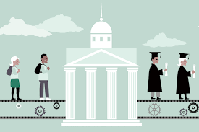
https://www.extension.harvard.edu/inside-extension/how-students-balance-full-time-work-school
How Students Balance Full-Time Work and School
Earning a degree is one way to get on a path toward a more gratifying career. But it presents a dilemma for those who need to maintain full-time employment. A job is necessary to pay for school (and life), but school may demand some of the time you typically dedicate to work.

Slide 14
https://www.extension.harvard.edu/inside-extension/how-students-balance-full-time-work-school

Slide 15
Reality of graduate education in the US
In his published research Andrew Crain explores chaos theory and its relevance to graduate student career development. Some quotes follow:
For doctoral students; many academic departments approach graduate education as something of a cloning process, focused almost exclusively on developing the next generation of faculty members in their field.
An open-systems approach to career planning rather than a closed-systems one.
Career decisions are intertwined in complex ways with other facets of one’s life -- relationships, community, health, the economy -- each of which is ever changing and somewhat unpredictable.
Students should network relentlessly.

Slide 16
What are we doing at Tsu?
Evening Classes
Online Classes/Programs
Advising - Academic and Career
Degree Completion Plans
Career Fairs / Job Fairs
Internships / Practicums
Professional Development Workshops
Invited Speakers
Industry Partnerships
Incubators
Research Week
On Campus Conferences
TA, GA, RA, Lab/Tech Assistant, Tutor
Graduate School Tuition Fellowships
Graduate Student Travel Grants
TSU Career Center

Slide 17
TSU Career Center

Slide 19
Graduate Program in Pharmaceutical Sciences
Preparing graduates for their career path in pharmaceutical sciences:
Students register for 1 credit hour seminar and 1 credit hour grantsmanship course that are offered in every Spring and Fall semester, respectively – Building student skills in academia jobs
Students are required to make a minimum two presentations of his/her research work in a national meeting, for example, American Association of Pharmaceutical Scientists (AAPS); American Society of Clinical Pharmacology & Therapeutics (ASCPT) - Building student skills in networking and industrial and academia jobs
Students participate in the Departmental monthly seminar series with speakers from drug company, FDA, and universities - All students have opportunities to meet speakers for career advise and networking
Students are paired with former graduates from the program for one-on-one mentoring activities
Students are encouraged to participate in a summer research internship in another institute, drug company, government agencies, etc.

Slide 20
Graduate Program in communication
The School of Communication recognized the need for and implemented a graduate program concentration that allows students to gain job readiness skills.
The concentration was aimed at recent graduates with media skills who wanted to work with professionals in digital media and storytelling.
Each student is required to complete a professional project. Students are prepared to design, produce and package media content for various applications - creative, corporate, medical, and training.
Despite limited resources and budget freezes, the program has thrived. As a result of the emphasis on professional skills in writing, planning, shooting, editing and recording the graduate program has consistently maintained an annual enrollment of 80 to 90 students. Last spring 20 students graduated in the professional program.
Some of the MA graduates have found jobs in the media and with non-profit organizations in Houston, Los Angeles and Atlanta. One has gone to Voice of America.

Slide 21
College of Education
Career Paths: In the College of Education, it starts with the interview of the applicant. In the interview we try to get a good sense of what are the applicant’s career goals. By doing so we can determine which program in the College is the best fit for the applicant. Once an applicant is accepted and becomes a student, the student sits with his or her advisor to discuss the student’s specific degree plan. The student’s advisor remains assigned to the student until graduation. The Advisor ensures the student is taking the correct classes as well as addresses any academic or career path questions.
Job Readiness: Our programs are designed to make sure they are aligned with its specific accrediting agency; thereby the classes are also aligned to teach what is expected in their field once they graduate from our programs.
Job Readiness: During the course of the program, students are provided professional development workshops related both to their field of study as well as their career goals. Students are also required to complete internships/practicums in their designated field of study.
Liaison with local School Districts for providing career trajectory opportunities.

Slide 22
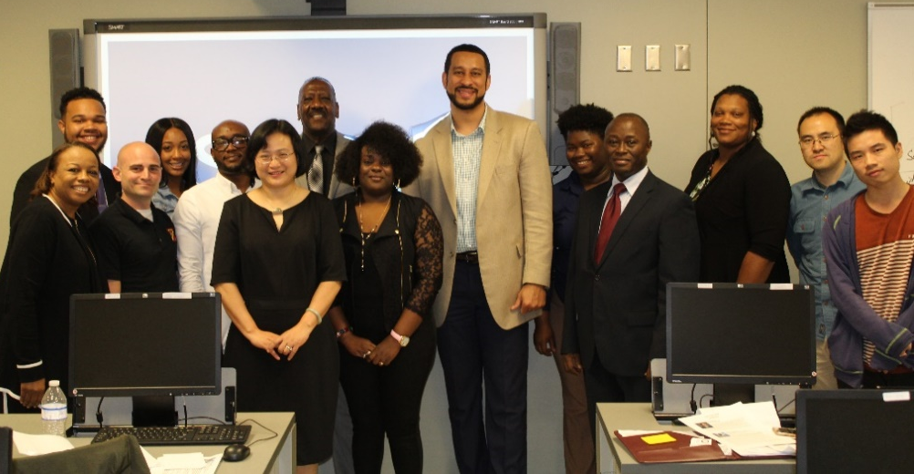
Graduate program in transportation
“Fast Forward Leadership and Skills Development Workshop” is a signature event organized by the Department of Transportation Studies very year. The event is designed to focus on leadership and soft skills training that the students may not receive in a traditional classroom setting. Workshop topics included: Professional Communication Skills, Leading with Excellence, Conflict Resolution, and Dealing with Change.

Slide 23
Graduate program in computer science
Since 2017, the CS department, with the help of Mr. Kevin Burleigh, Senior Software Developer at Rice University, has been organizing weekly sessions on Fridays from 3 to 7 PM for undergraduate and graduate students focusing on
Resume writing
Technical interview preparation

Slide 24
School of business
JHJ Graduate Student Association Career Fair
Business Incubator
Business Advisory Council
Nu Boule – Men’s Mentoring Program
Links – Women’s Mentoring Program
JHJ Alumni Week
JHJ Money Week
CPA Boot Camp
Resume Boot Camp

Slide 25
Some industry partnerships
JP Morgan Chase
Amegy Bank
Microsoft
Oracle
Hewlett Packard
H-E-B
Kroger
Enterprise
Houston Retail Leadership Academy
Thurgood Marshall Leadership Institute
ConocoPhillips
State Farm Insurance
Womack Development
Houston City Airport Systems
Precision Drilling
Ernst & Young
Deloitte
Raytheon
Shellpoint
Texas Oil Tech Laboratories
DuCharme, McMillen & Associates, Inc.
Smith Graham Investment Firm
Dept. of Energy
KPMG
MD Anderson
MLB (Major League Baseball)

Slide 26
NSF Grant
Rice University, Texas Southern University (TSU) and the University of Houston (UH) have won a multimillion-dollar grant to help increase the number of underrepresented minorities pursuing academic careers in engineering and science.
The NSF grant for $2.66 million over five years is part of its Alliances for Graduate Education and the Professoriate (AGEP) program, which seeks to "advance knowledge about models to improve pathways to the professoriate and success" for historically underrepresented minorities in science, technology, engineering and math (STEM) disciplines.
The award is specially for those in data engineering and data science disciplines.

Slide 27
Some Options we would like to explore
Using Digital Badges To Promote Professional Development and Job Readiness
Integrating Stackable, Competency-Based Micro-credentials into Academic Programs
Industry Standard Certifications
More Certificate Programs

Slide 28
General information

Slide 29
https://www.onlineschoolscenter.com/micro-credentials/

Slide 30
Balancing Graduate Education and the Development of a Career Trajectory Conclusion / recap
What are we doing?
What do we plan to do?
Is what we are doing enough?
How can we do more?
Ideas / Thoughts / Share / Suggestions / Questions?

Slide 31
TSU Graduate School
The Graduate School
Texas Southern University
Hannah Hall 211 (HH 211)
3100 Cleburne St., Houston, TX 77004
Phone: (713) 313-4410
http://www.tsu.edu/graduateschool

